Slide 1
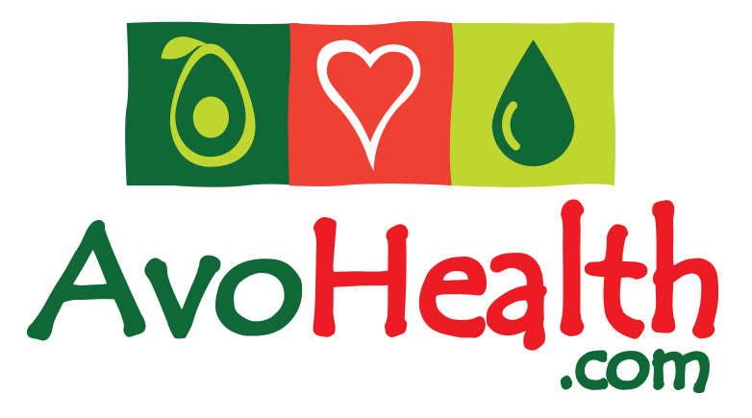
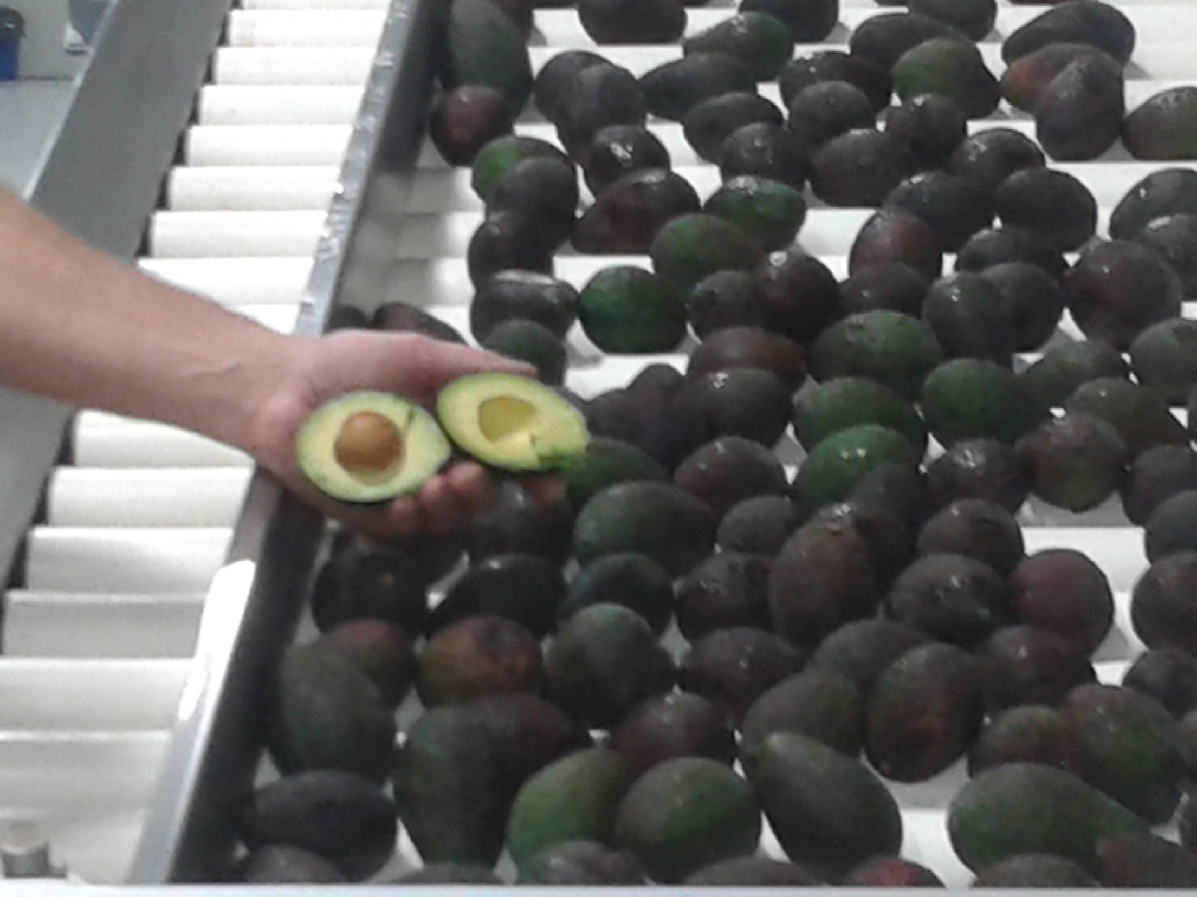

Is there a Good Business Case to Press Avocado Oil?
Every location and every situation is unique & requires specific analysis. In general we only work with those who have:
a desire to create competitive advantage by operating at a
reasonable scale.
2. cool winter temperatures.
3. A good supply of process grade avocado
at competitive prices.
Notes:
In 1999, Andrew Logan, the founder of AvoHealth and Healthy Oils Limited, was first in the world to make cold-pressed Extra Virgin Avocado Oil. Andrew has been continuously involved with this business since 1998.
The international oil business is ‘highly competitive’. We compete against very cheap, low quality, less healthy food oils.
But increasingly consumers all over the world are aware of the differences between “good fats” and “bad fats”.
.... AvoHealth technologies & knowledge ensure our Extra Virgin Avocado Oil is one of the healthiest, best tasting and highest quality vegetable oils anywhere in the world.

Slide 2
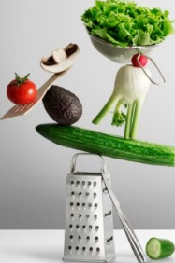
Fresh avocado - the healthiest fruit on earth.
Many healthy attributes in fresh avocado are multiplied in avocado oil.
World Demand for Vegetable Oils: >200 million tonnes p.a. - demand per person increases each year.
Markets increasingly aware of “Good Fats” versus “Bad Fats”
Avocado Oil is one of the healthiest “Good Fats”.
Notes:
In 1999, Andrew Logan, the founder of AvoHealth and Healthy Oils Limited, was first in the world to make cold-pressed Extra Virgin Avocado Oil. Andrew has been continuously involved with this business since 1998.
The international oil business is ‘highly competitive’. We compete against very cheap, low quality, less healthy food oils.
But increasingly consumers all over the world are aware of the differences between “good fats” and “bad fats”.
.... AvoHealth technologies & knowledge ensure our Extra Virgin Avocado Oil is one of the healthiest, best tasting and highest quality vegetable oils anywhere in the world.

Slide 3
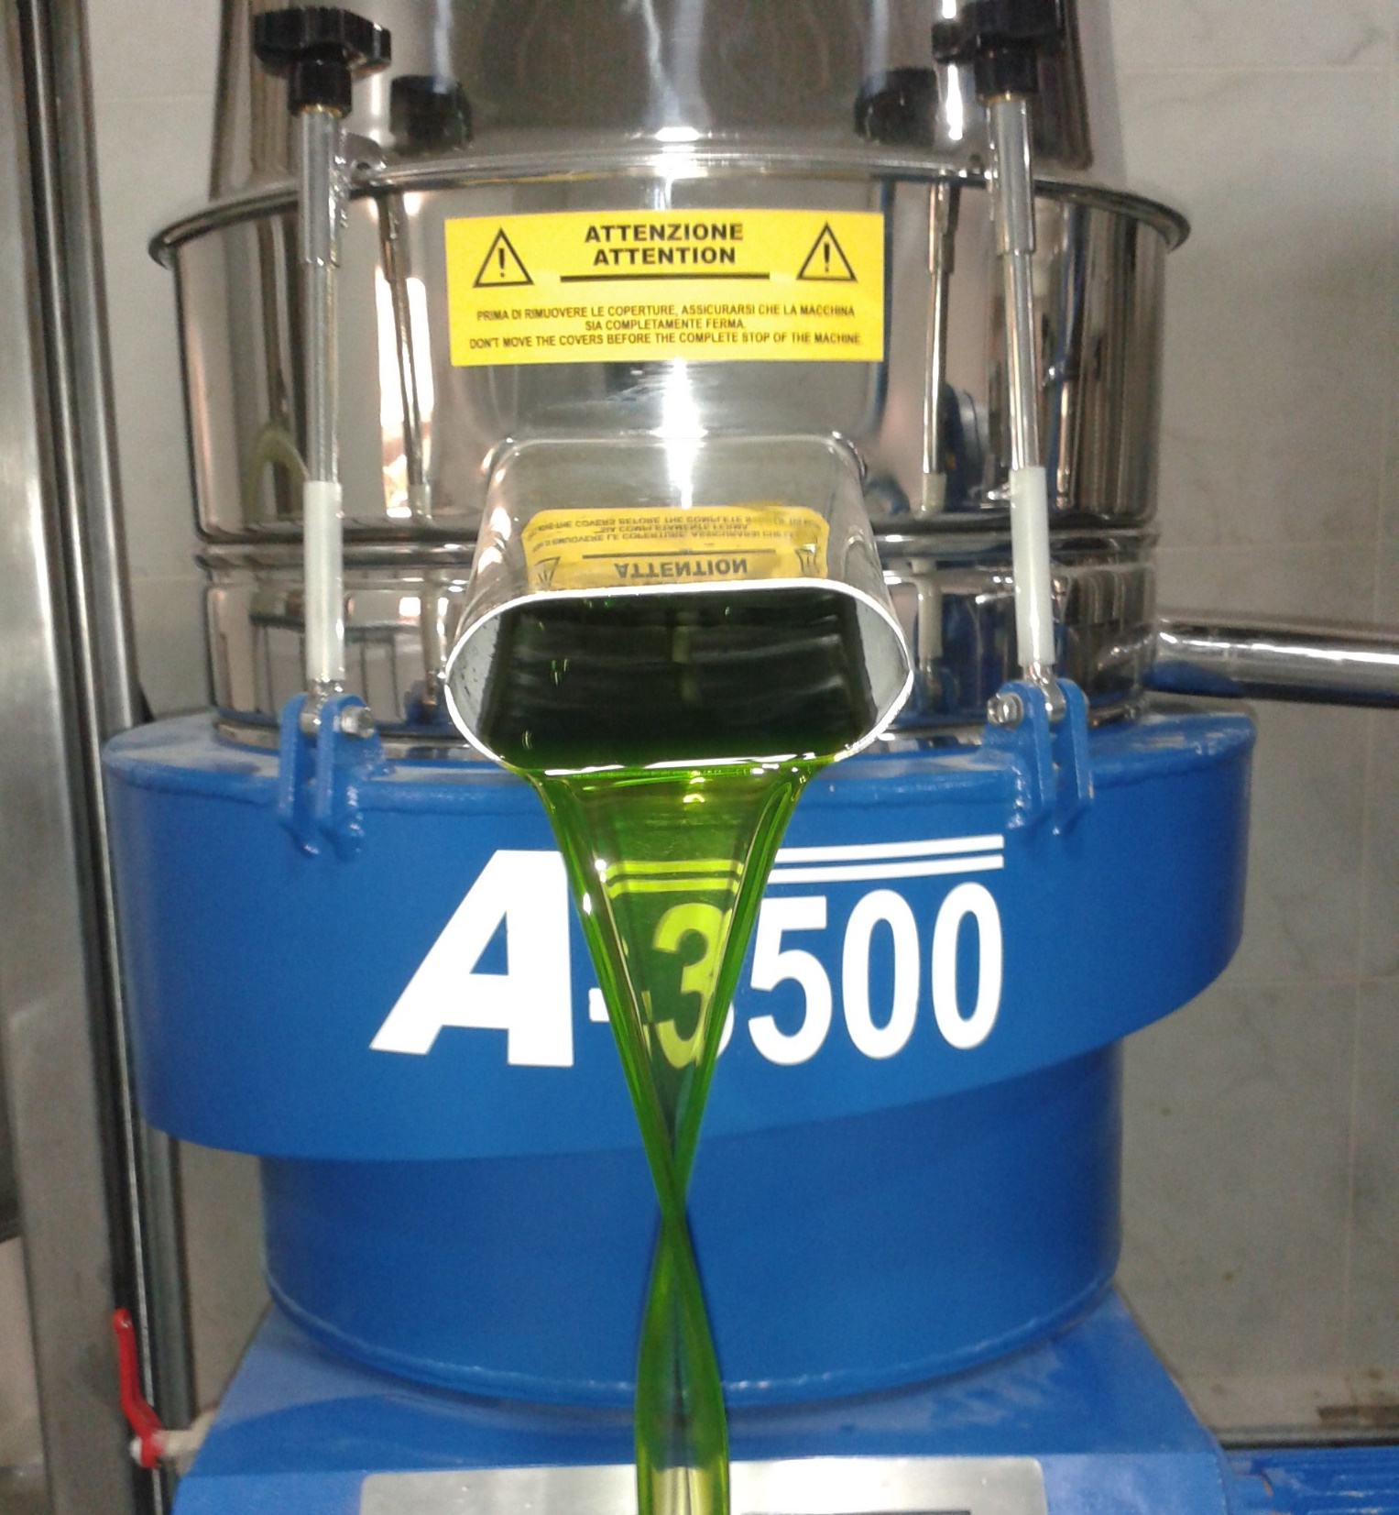
Extra Virgin or Raw/Crude Avocado Oil
Extra Virgin – every aspect of production, then packaging processes must be ‘perfect’. Markets are often smaller and slower to establish. Additional capital usually required.
Raw/Crude Avocado Oil is pressed to more
relaxed standards than Extra Virgin.
We recommend:
Having equipment to process both grades.
Setting a focus on pressing Raw Avocado Oil.
Notes:
In 1999, Andrew Logan, the founder of AvoHealth and Healthy Oils Limited, was first in the world to make cold-pressed Extra Virgin Avocado Oil. Andrew has been continuously involved with this business since 1998.
The international oil business is ‘highly competitive’. We compete against very cheap, low quality, less healthy food oils.
But increasingly consumers all over the world are aware of the differences between “good fats” and “bad fats”.
.... AvoHealth technologies & knowledge ensure our Extra Virgin Avocado Oil is one of the healthiest, best tasting and highest quality vegetable oils anywhere in the world.

Slide 4
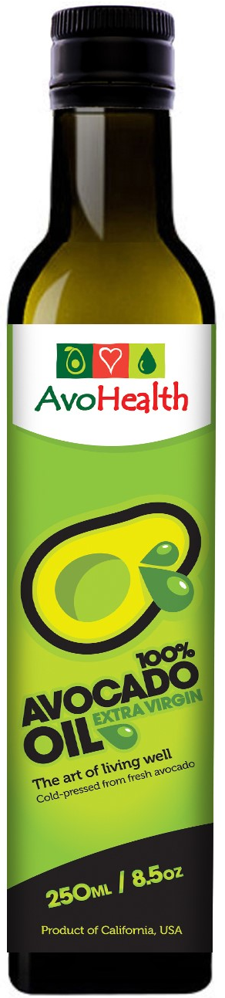
The Target Markets
Avocado Oil markets are small, complex + price sensitive.
We know we can increase market demand if we can offer competitive pricing.
Target markets include:
Often AvoHealth arranges 100% of marketing.
#1: Retail Food | #4: Bulk Food Ingredients
#2: Private Label Retailers | #5: Cosmetic Manufacturers
#3: Food Service Sector | #6: Nutraceutical ingredients
Notes:
In 1999, Andrew Logan, the founder of AvoHealth and Healthy Oils Limited, was first in the world to make cold-pressed Extra Virgin Avocado Oil. Andrew has been continuously involved with this business since 1998.
The international oil business is ‘highly competitive’. We compete against very cheap, low quality, less healthy food oils.
But increasingly consumers all over the world are aware of the differences between “good fats” and “bad fats”.
.... AvoHealth technologies & knowledge ensure our Extra Virgin Avocado Oil is one of the healthiest, best tasting and highest quality vegetable oils anywhere in the world.

Slide 5
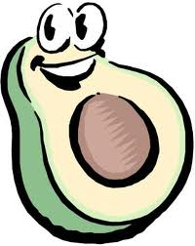
There are always Recognized Risks:
Agri-Processing - always subject to climate extremes/change everywhere in the world.
In some areas we may not have exact data about oil yield + length of processing season.
Unpredictability – Many countries present unexpected challenges. We always need to be flexible in approach.
4. Support infrastructure is often a challenge.
5. The abilities of the production company.
Notes:
In 1999, Andrew Logan, the founder of AvoHealth and Healthy Oils Limited, was first in the world to make cold-pressed Extra Virgin Avocado Oil. Andrew has been continuously involved with this business since 1998.
The international oil business is ‘highly competitive’. We compete against very cheap, low quality, less healthy food oils.
But increasingly consumers all over the world are aware of the differences between “good fats” and “bad fats”.
.... AvoHealth technologies & knowledge ensure our Extra Virgin Avocado Oil is one of the healthiest, best tasting and highest quality vegetable oils anywhere in the world.

Slide 6
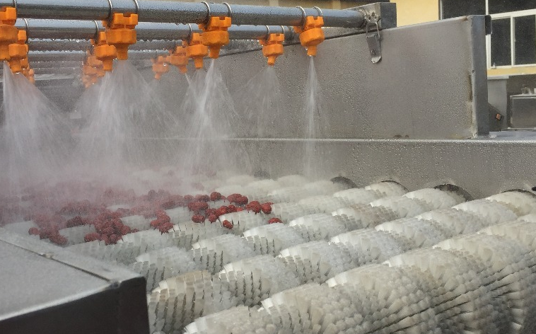
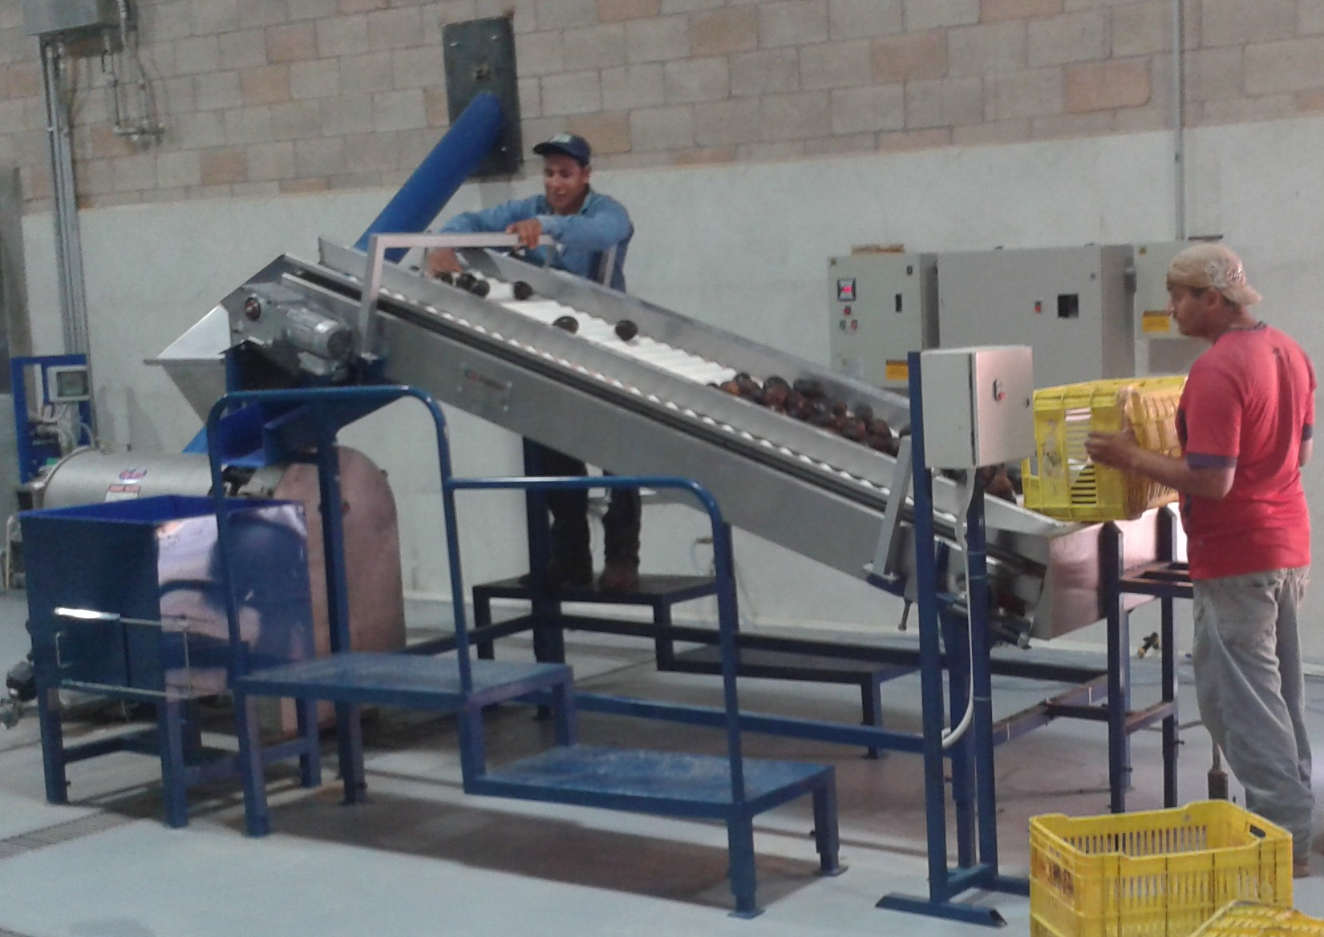
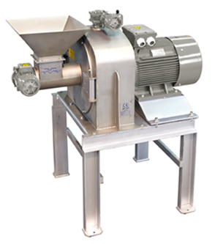
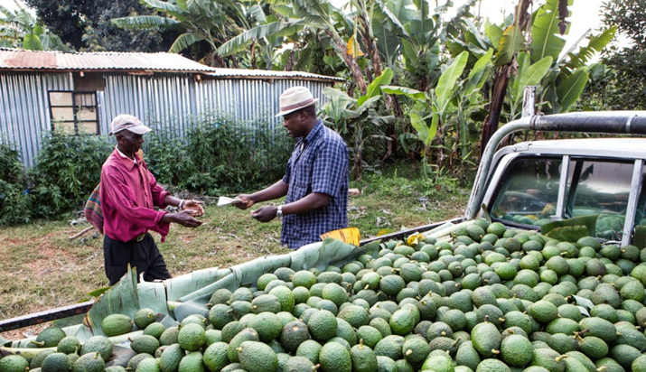
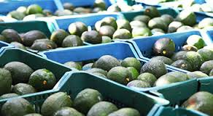
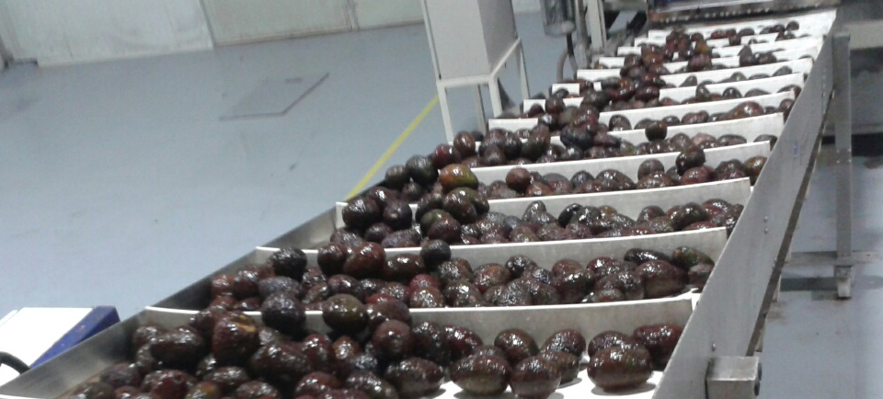
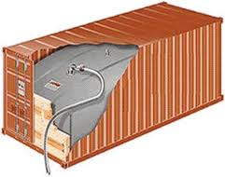
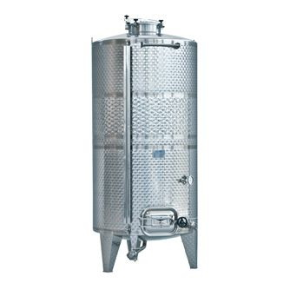
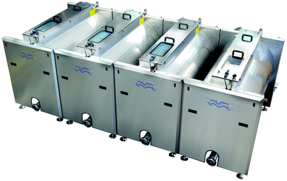
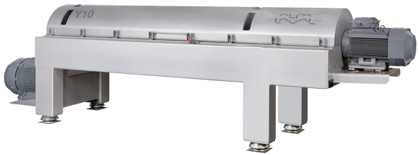
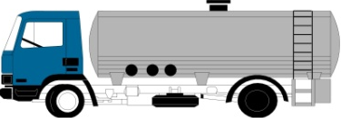
AvoHealth – Avocado Oil Process Line
Avocado Supply
Harvested avocado arrive at production plant.
Fresh Avocado
Storage & controlled ripening
Conveyor Feed + Quality Control
Feeds avocado into the processing system
Fruit Washer
washes the skin
of each avocado
De-Seeder
Removes avocado seed + skin.
Hammer Crusher
Crushes entire avocado into pulp.
And/Or
CONTROL PANEL
Ship to Packing Plant
Oil Storage
Store in large tanks to remove some waxes
Separator
Cleans & polishes oil;
Removes moisture
& impurities
Decanter
Centrifuge separates avocado oil from waste water & solids
Malaxers
Gently mixes pulp.
Oil starts to separate

Slide 7

Summary: Avocado Oil is an excellent business
There are very few avocado oil producers in the world.
All major business opportunities require careful assessment.
Many machinery companies are “salesmen” with very limited Avocado Oil expertise.
Machines are only part of the total cost. E.g. you also
need a production factory & working capital.
5. Typically costs US$1,000+ per hour to run a production
line. It’s important to take advice!!
Notes:
In 1999, Andrew Logan, the founder of AvoHealth and Healthy Oils Limited, was first in the world to make cold-pressed Extra Virgin Avocado Oil. Andrew has been continuously involved with this business since 1998.
The international oil business is ‘highly competitive’. We compete against very cheap, low quality, less healthy food oils.
But increasingly consumers all over the world are aware of the differences between “good fats” and “bad fats”.
.... AvoHealth technologies & knowledge ensure our Extra Virgin Avocado Oil is one of the healthiest, best tasting and highest quality vegetable oils anywhere in the world.

